Slide 1
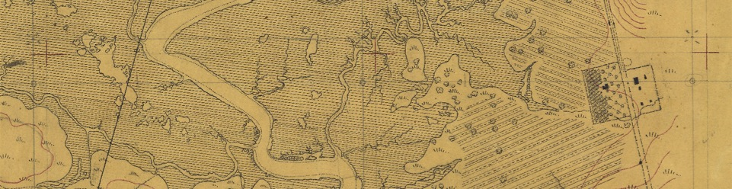

Considerations in
Working with Traditional Knowledgebases
Chuck Striplen, PhD
San Francisco Estuary Institute – Aquatic Science Center

Slide 2
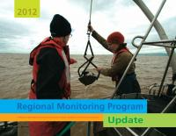
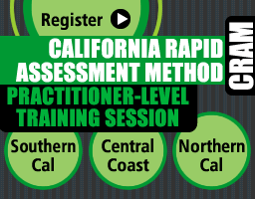
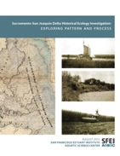

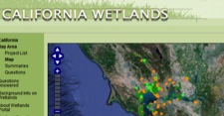
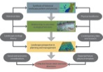
ENVIRONMENTAL INFORMATICS
RESILIENT
LANDSCAPES
CLEAN WATER
Bay RMP
Nutrient Analysis

Slide 3
Considerations in Working with Traditional Knowledgebases
…“society needs to find a way to draw on multiple perspectives, and as much detailed knowledge as possible integrated from local to regional to global scales, to develop solutions to climate change adaptation and amelioration that are effective and participatory. Society’s resilience depends on diversity.
Turner & Spalding 2013

Slide 4
Considerations in Working with Traditional Knowledgebases
Theoretical considerations
Available information and access
Science needs
Cultural landscape mapping (archaeology + ethnography + historic and contemporary resources)

Slide 5
Working with a TEK knowledgebase
Theoretical considerations
Available information and access
Science needs
Cultural landscape mapping (archaeology + ethnography + historic and contemporary resources)

Slide 6
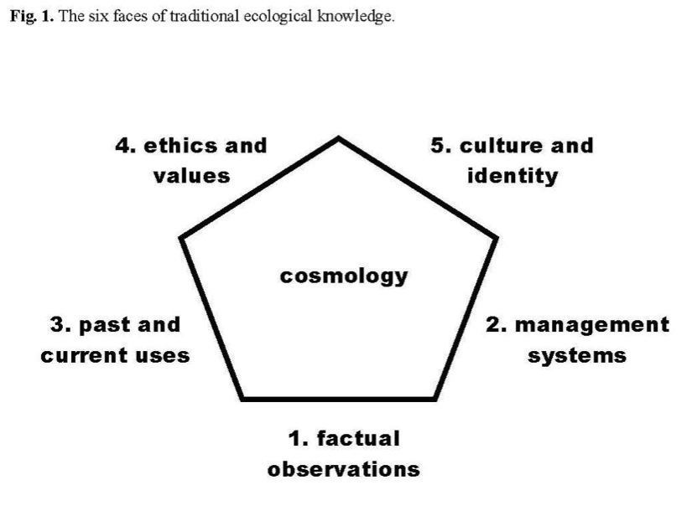
Houde 2007

Slide 7
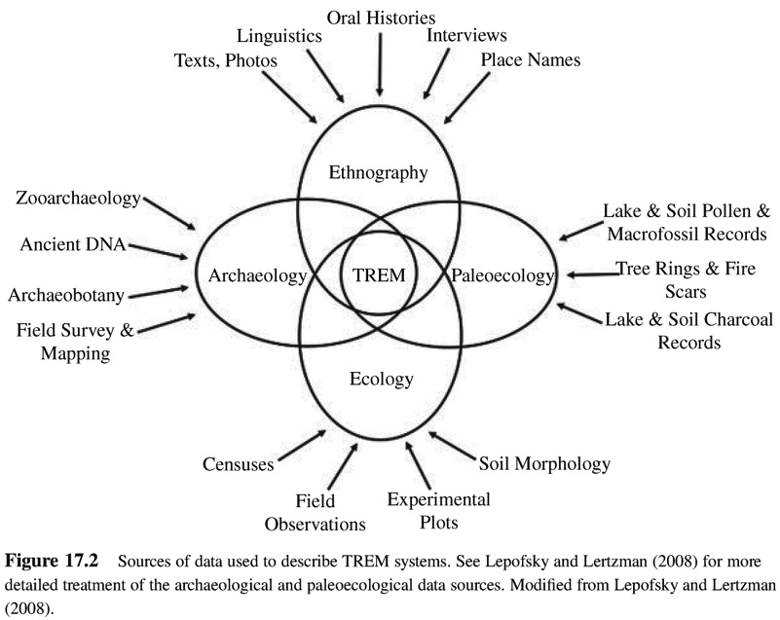
Fowler & Lepofsky 2011

Slide 8
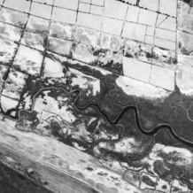
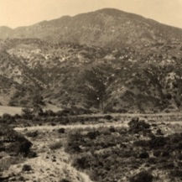
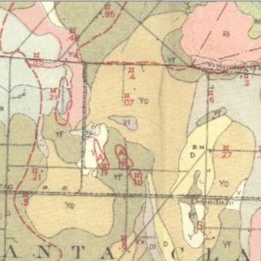
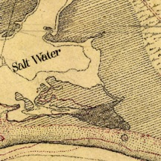
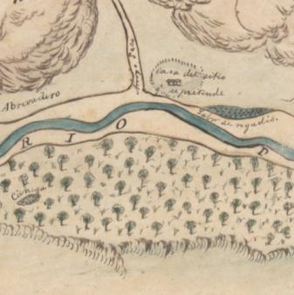
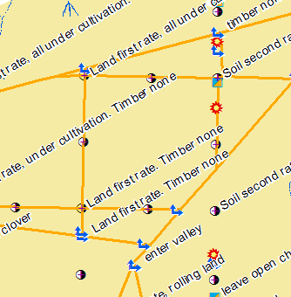
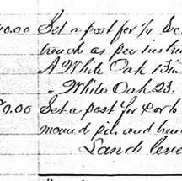
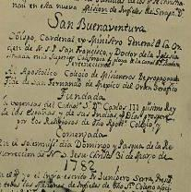
Historical data
Photographs
Maps
Texts
Notes:
Backbone = historical picture
To document historical characteristics on SCR…
We reviewed literally thousands and thousands of documents
maps, texts, photographs from different points in history, made for different reasons
Here’s sample of some of our favorite sources:
many different sources from different times in history:

Slide 9
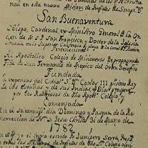
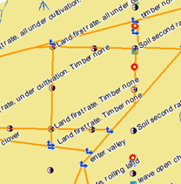

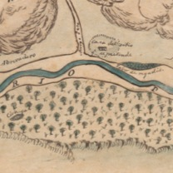
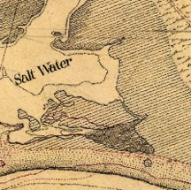

1800
1850
1900
1950
2000
Notes:
To do this, SFEI works with many disparate data sources that span the 273 years since California’s colonization
As we bring this information together, GIS is one of our primary tools for working with our sources to recognize spatial patterns and process and map the historical landscape
We collect many different sources from different times in history:
-Explorer’s journals, mission records
-Diseños and land grant documents
-PLS
-county maps
-soil surveys
-aerial AND landscape photography
(CLICK)

Slide 10
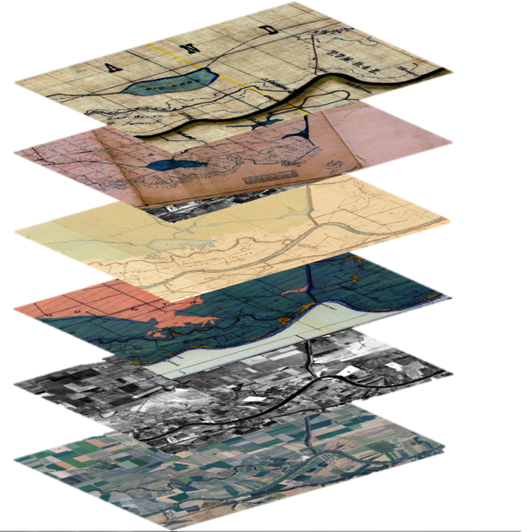
ca. 1880
1914
1909-1918
1930
1937
2005

Slide 11
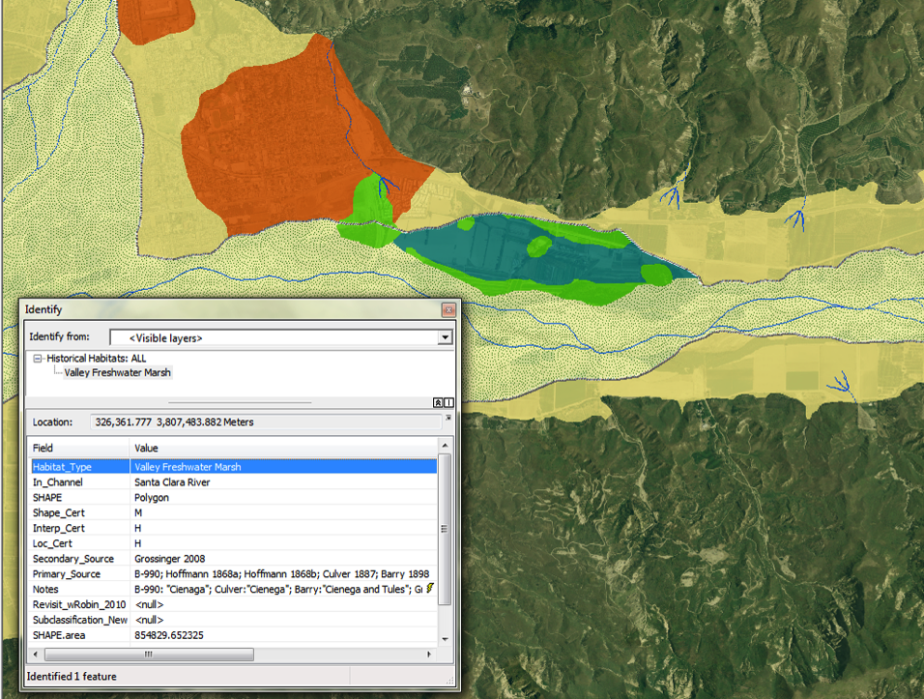
 | Interpretation | Size/Shape | Location
High | “Definite” | +/- 10% | Within 150 feet
Medium | “Probable” | +/- 50% | Within 500 feet
Low | “Possible” | +/- 25% | Within 2,000 feet
Notes:
Each polygon attributed

Slide 12
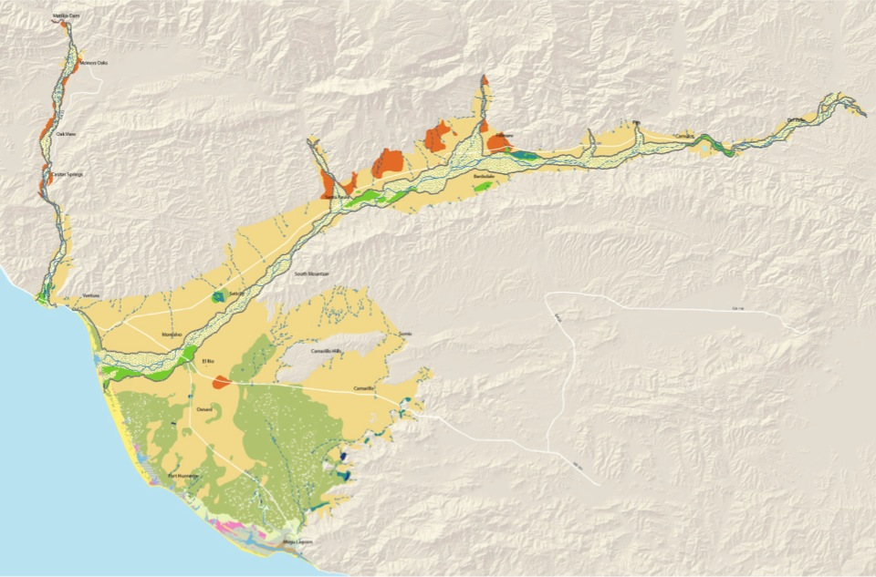
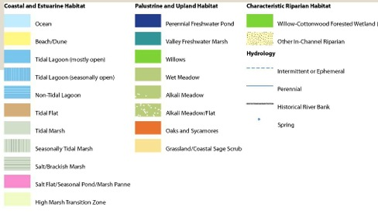
historical habitat map (ca. 1850)
Notes:
Result of all this effort:
Product 1: the habitat map, habitat patterns ca. 1850 (prior to major modification)
I know you can’t read the legend so I’ll walk you through this
Today, we’ll talk about all these things: detail of coastline, SCR/Ventura patterns…in more detail
Map becomes a product – w/all attributes, sources -- that goes hand in hand with our report
Before we get into each region, a brief discussion of general patterns:
Mapped wetlands, drylands
Relatively few wetlands outside river channel (Saticoy springs is major exception)

Slide 13
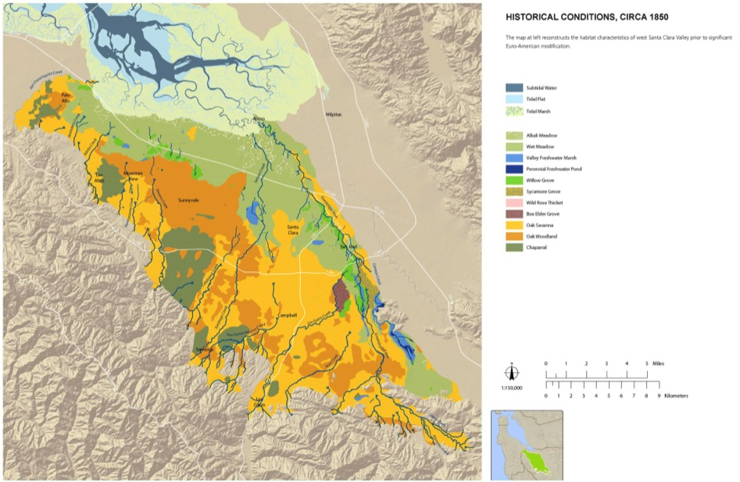

Slide 14
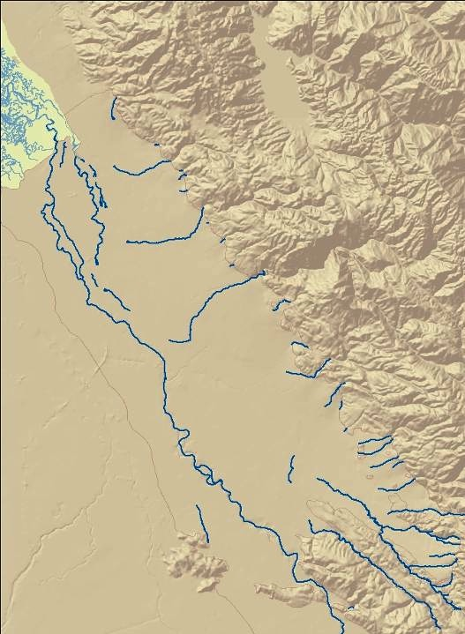
Fluvial channel network change
Historical Coyote Creek
Drainage Network
1800:
“disconnected” system
San Jose

Slide 15
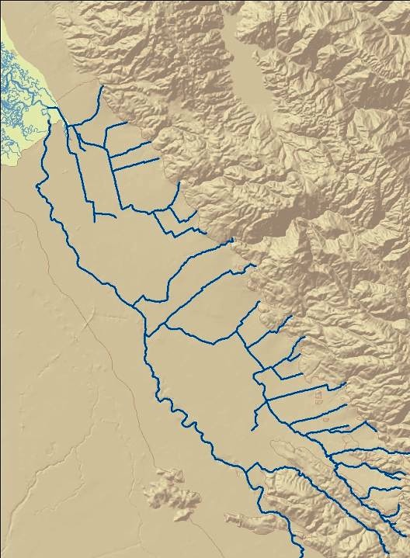
Fluvial channel network change
Modern Coyote Creek
Drainage Network
2005:
“increased connectivity”
San Jose

Slide 16
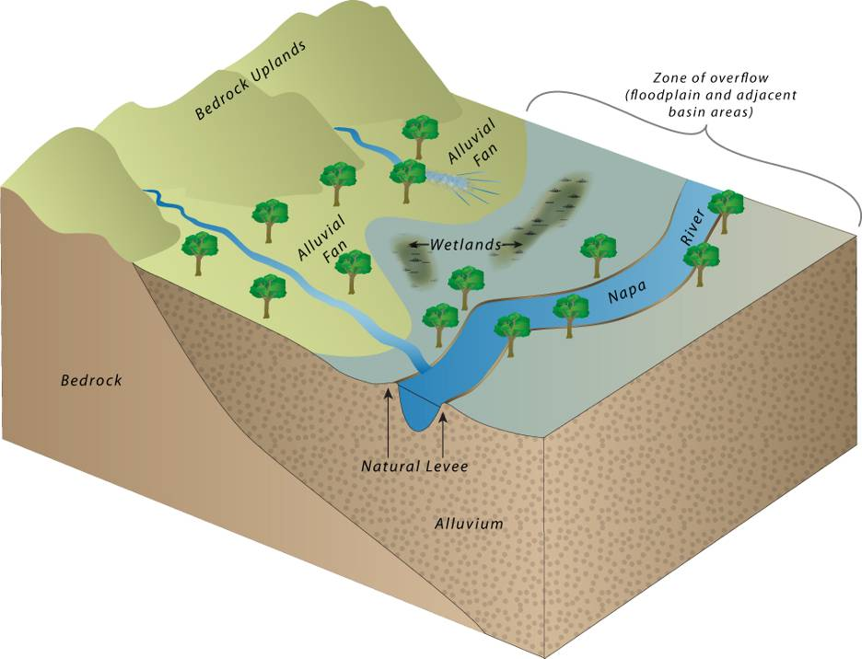
Notes:
ADD TREEES

Slide 17
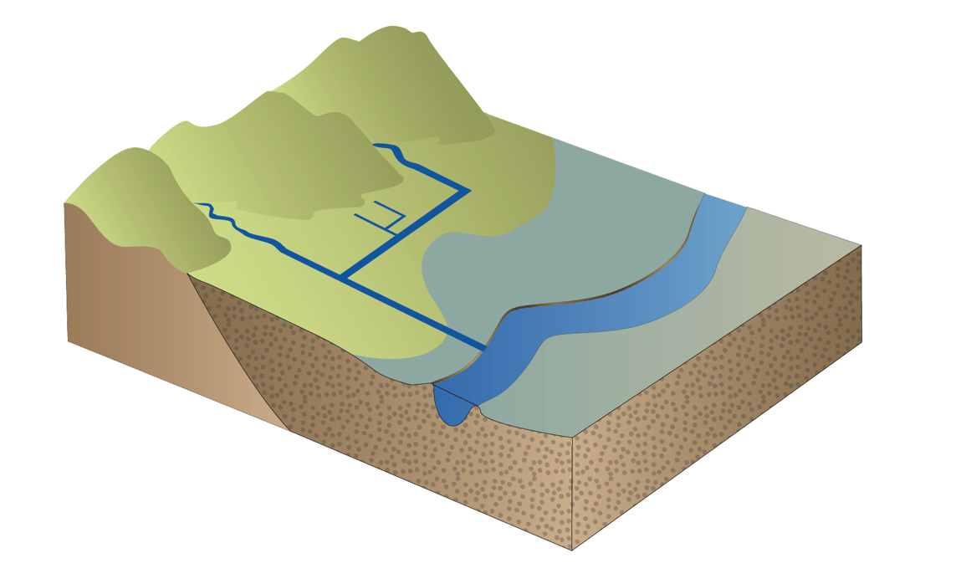

Slide 18
Fowler & Lepofsky 2011

Slide 19
Working with a TEK knowledgebase
Theoretical considerations
Available information and access
Science needs
Cultural landscape mapping (archaeology + ethnography + historic and contemporary resources)

Slide 20
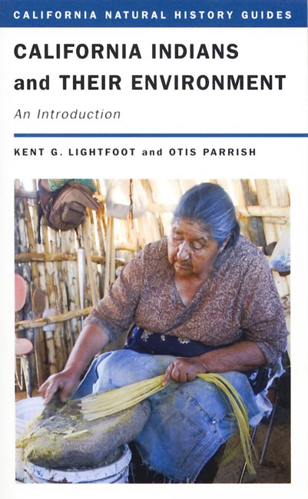
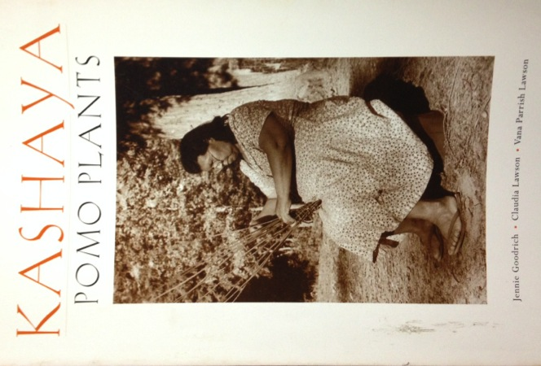

Slide 21
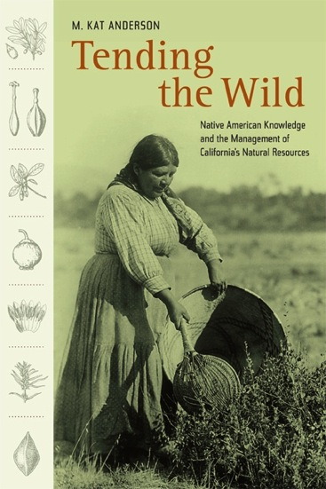
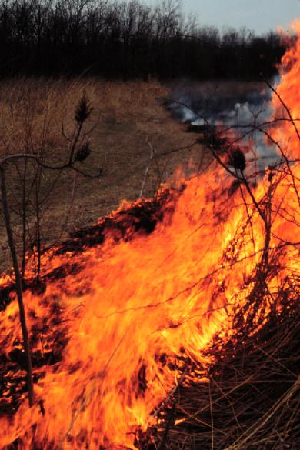
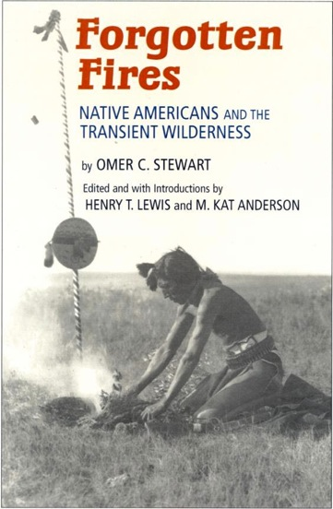

Slide 22
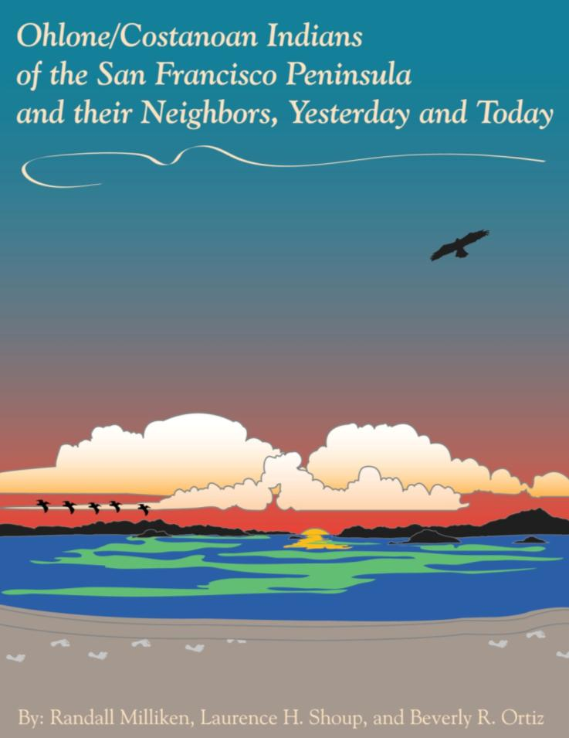
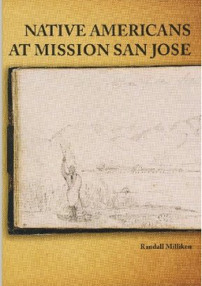
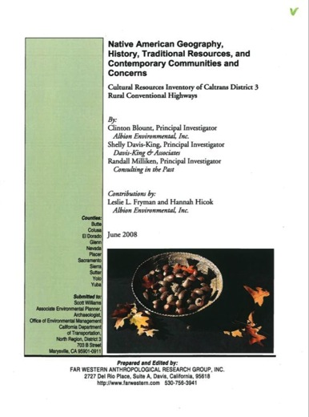

Slide 23
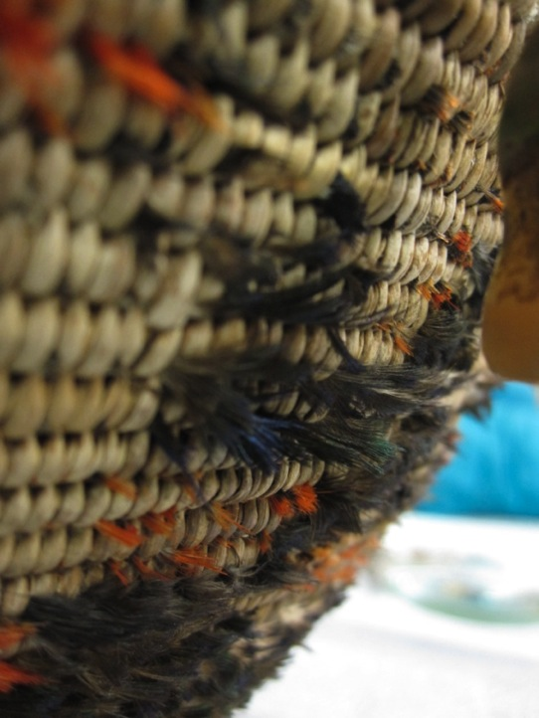
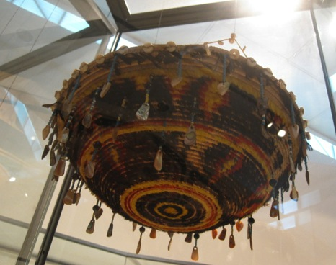
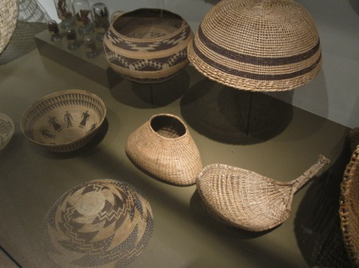

Slide 24
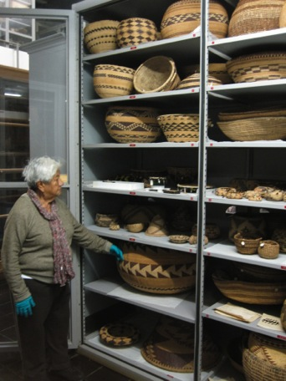
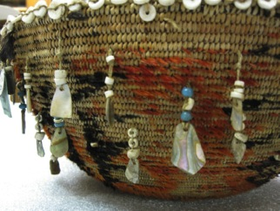
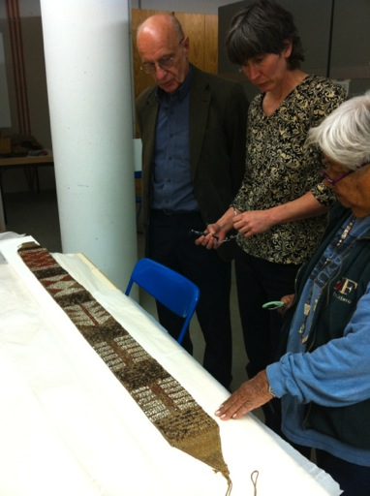
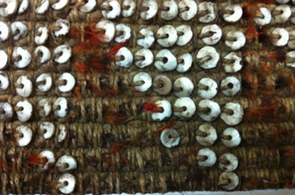

Slide 25
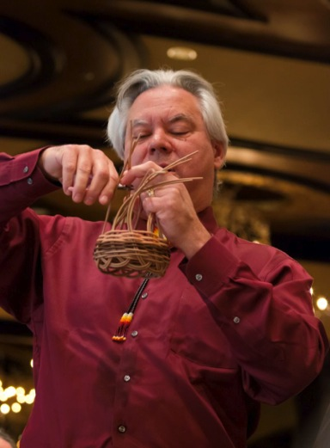
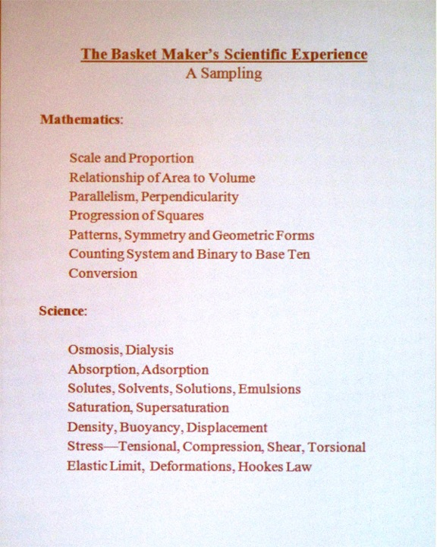
Dr. Eric Jolly, President
Science Museum of Minnesota

Slide 26
1 cradleboard = ~500-675 straight sticks from healthy, recently burned plants (hazel, willow, sourberry)
1 medium-sized cooking basket = ~3,750 deergrass stalks, willow sticks, or sedge roots from 75-100 healthy, recently burned plants
1 foot of cordage = 5 stalks of milkweed or Indian hemp
1 ceremonial feather skirt or cape = 100’ of cordage from ~500 plant stalks
1 deer net = 7,000’ of cordage from ~35,000 plant stalks!!!
“Average” tribal community size in California of 850 individuals would require
~150mi² territory for required food, fuel, and raw materials
Blackburn & Anderson 1993

Slide 27
Considerations in Working with Traditional Knowledgebases
Theoretical considerations
Available information and access
Science needs
Cultural landscape mapping (archaeology + ethnography + historic and contemporary resources)

Slide 29
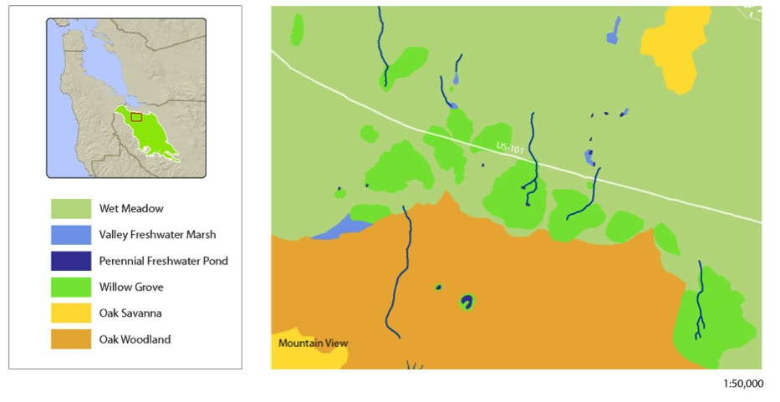

Slide 30
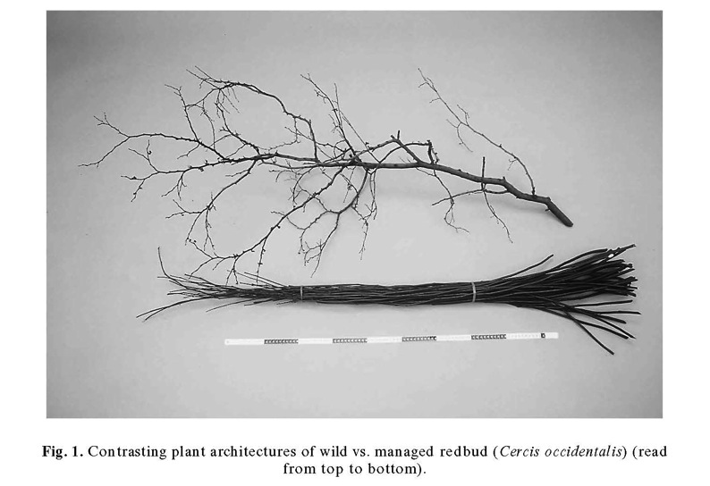
Anderson 1999

Slide 31
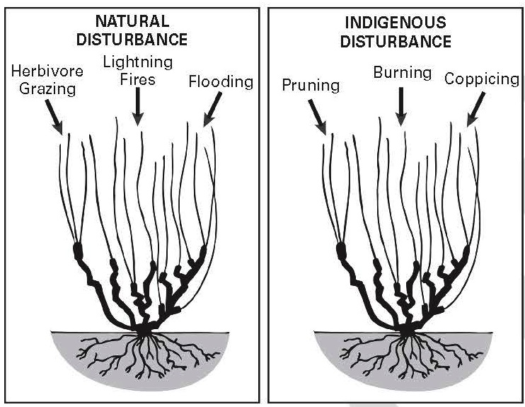
Anderson & Wohlgemuth 2012

Slide 32
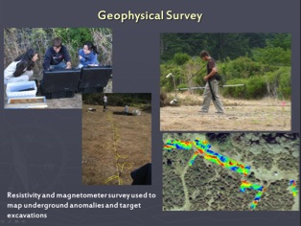









Slide 33





Archaeology in Quiroste Valley

Slide 34

Fire ca 1895

Slide 35

Striplen & Jones 2012 unpubl. data

Slide 36
Considerations in Working with Traditional Knowledgebases
Theoretical considerations
Available information and access
Science needs
Cultural landscape mapping (archaeology + ethnography + historic and contemporary resources)

Slide 37

Distribution of Tribal Communities around the Greater Bay Region, circa AD 1770.
(Map from Milliken et al. 2009).
Notes:
We’re a unrecognized tribe from the Monterey Bay region of central CA, with a membership of about 600 – and a territory covering most of four counties, dozens of municipalities, and more than 50 miles of coastline.
(CLICK)

Slide 38

Notes:
But even Recognized tribes face many of the same issues we do in off-Reservation contexts. In California, 109 federally recognized tribes currently possess less than 2% of their original lands. Many Tribes remain landless, a great number still without federal recognition, and most possess limited capacity, authority, or opportunity to engage in watershed-level planning and resource protection outside the reservation.
At the same time - there now exists a significant infrastructure dedicated to building Tribal capacity for recognized tribes to manage and regulate the environmental resources and challenges on their own lands – many of which have been highly successful and innovative.
However, given that off-reservation lands still retain important cultural resources, cemeteries, sacred places, and important modern and historic gathering areas…….
(CLICK)

Slide 39


Slide 40


Slide 41

Whipple et al. 2012

Slide 42

Whipple et al. 2012

Slide 43

[Native Californians burned] “so that new weeds may grow to produce more seeds” (1769)
From
Richard Minnich California’s Fading Wildflowers,
Lost Legacy and Biological Invasions
2008
[The scouts for Portola found] “pasture upon the other side [of the bay] had all been burnt and was toilsome for the mounts” (1769)
Notes:
43
1769 a Spanish explorer speculated that the [Native Californians burned] “so that new weeds may grow to produce more seeds” (1769)

Slide 44



Secular/academic research
Tribal Research
Synthesis of historical landscape form and function
Contemporary data and research
Ecological theory
Landscape perspective in planning
Conceptual models, identified opportunities, landscape metrics
Social and economic constraints
Expected future physical template
Future vision and implementation strategies

Slide 45
SFEI-ASC Cultural Landscapes Program
Collaborative data development
Identifying areas where shared or convergent conservation goals can engender broad-based collaboration in data development to aid watershed planning and mitigation (i.e. historical ecology/cultural landscapes);
Institutional capacity [tribal and non-tribal]
Identifying needs or additional support across the gamut of tribes, agencies, counties, municipalities, and museums that regularly interface over watershed planning and interpretation;
Interpretation and public engagement
Identifying gaps and opportunities in museum and curricular approaches to interpreting California’s “natural” landscape and the role of tribes in managing that landscape in the past, present, and future.

Slide 46
Embrace
Encourage
Enable
Empower

Slide 47
Thank you!
Contact
chuck@sfei.org

